Slide 1


PROJECT TITLE – SOCIAL NETWORK ANALYSIS OF FACEBOOK PAGES
TEAM MEMBERS-
1. Soumyaraj Roy ( 19BCE0200 )
2. Kaustubh Dwivedi ( 19BCE0249 )
3. Nishma Rebello ( 19BCE0253 )
4. Ayush Pandya ( 19BCE2697 )
This Photo by Unknown Author is licensed under CC BY-SA

Slide 2
ABSTRACT
Social networking sites like Facebook, Twitter, and Instagram are most visited domains on the Internet. They contain huge data about the users and the relationships among them.
We can analyze and mine useful information from these huge social network data.
The useful insights that we can generate from such data, can be used by corporates and organizations to improve their business models, and do target marketing campaigns.
Choosing an appropriate tool such as a programming language and its functions and libraries, we can use it to do social network analysis on Facebook pages.
We will use the R programming language for conducting the analysis on Facebook football related pages dataset and as our project deals with data analysis and statistics.

Slide 3
INTRODUCTION
In this project, we are going to use a graph dataset containing various data about number of Facebook pages of organizations directly or indirectly related to football. This information includes
a) fan_count (no. of likes of the page has received)
b) category (such as ‘Non-Profit Organization’, ‘Athlete’, ‘Company’, etc.)
c) username (assigned to distinguish every page)
d) users_can_post (can any Facebook user post to that page)
e) link (URL for the corresponding Facebook page)
f) post_activity g) talking_about_count (how many people have been talking about this page recently)
In the proposed system, we will be generating graph statistics and be producing visualizations which will greatly aid the reader in understanding the subtle nuances of the things happening behind the scenes. We will gain a greater understanding of graph theory and social media analysis than we do now.

Slide 4
METHODOLOGY-
We have taken a dataset from Kaggle platform. It is basically a graph dataset containing various data on over 500 Facebook pages of organizations which are directly or indirectly related to football.
Using the data from the dataset, we will be generating different statistics and graph statistical measures using the network of these pages as a graph structure. These statistics include -
1) aggregating pages based on their category, 2) top pages based on their fan count (likes).
3) top pages based on total people talking about them, 4) top pages based on page posting activity.
5) correlation between fans & talking about for pages.
6) Graph properties such as-
a) diameter b) edge density c) transitivity d) coreness e) centrality measures i.e. Betweenness, Closeness and Eigenvector
7) PageRank, 8) finding communities or clusters in the network
9) modularity score.

Slide 5
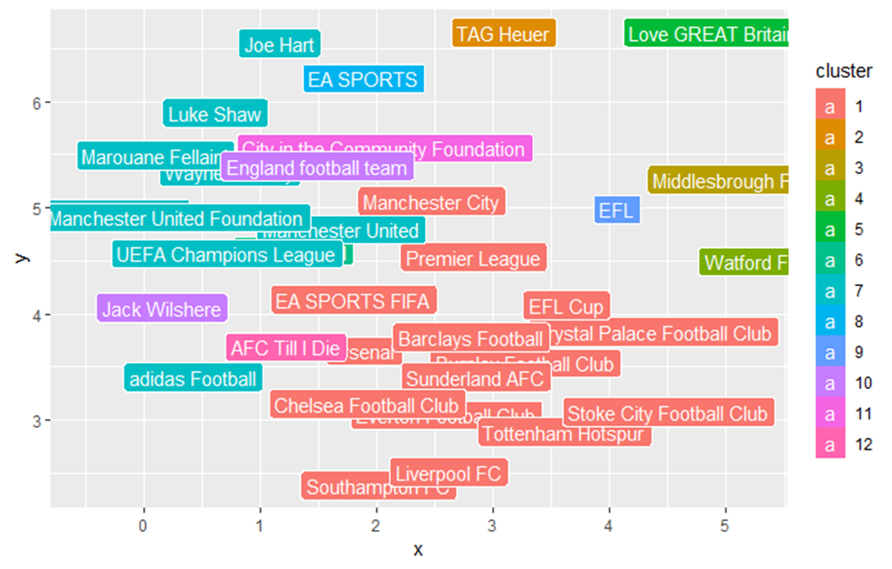
Edge betweness

Slide 6
Framework And Architecture of the Proposed System
The architecture of the proposed system consists of code chunks, each containing some code which can run independently of other chunks. I have outlined the modules and given their brief description below –
1. Importing the required libraries – gridExtra, igraph and ggplot2.
2. Reading in the graph and viewing its brief summary
3. Inspecting the page graph object
4. Aggregating pages based on their category
5. Top pages based on their fan count (likes)
6. Top pages based on total people talking about them
7. Top pages based on page posting activity
8. Checking correlation between fans and talking_about for pages:

Slide 7
9. Plotting page network using degree filter
10. Getting filtered graph
11. Plotting the graph
12. Diameter (length of longest path) of the network
13. Getting the longest path of the network
14. Mean distance between 2 nodes in the network
15. Distance between various important pages (nodes)
16. no. of edges / no. of all possible edges
17. transitivity clustering coefficient
18. The k-core of a graph is a maximal subgraph in which each vertex has at least degree k.
19. The coreness of a vertex is k if it belongs to the k-core but not to the (k+1)-core.
20. Max coreness
21. Viewing the core of the network
Viewing the periphery of the network
Degree centrality. Degree centrality assigns an importance score based purely on the number of links held by each node.
24. Closeness centrality
In a connected graph, the normalized closeness centrality (or closeness) of a node is the average length of the shortest path between the node and all other nodes in the graph. Thus, the more central a node is, the closer it is to all other nodes.

Slide 8
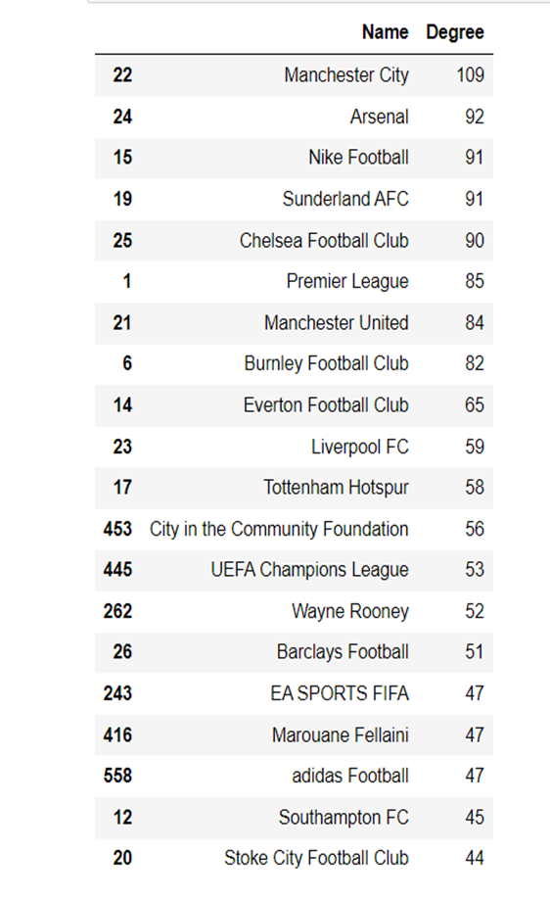
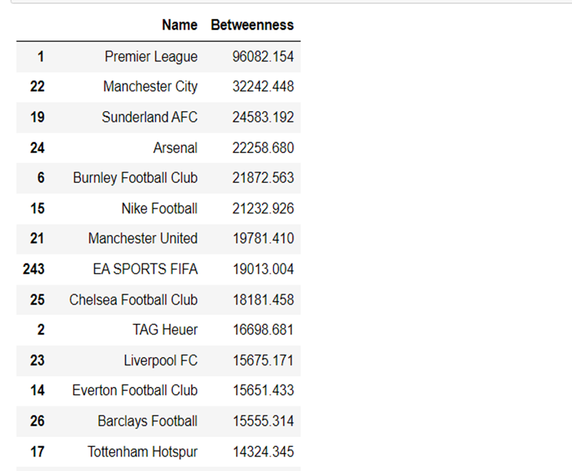
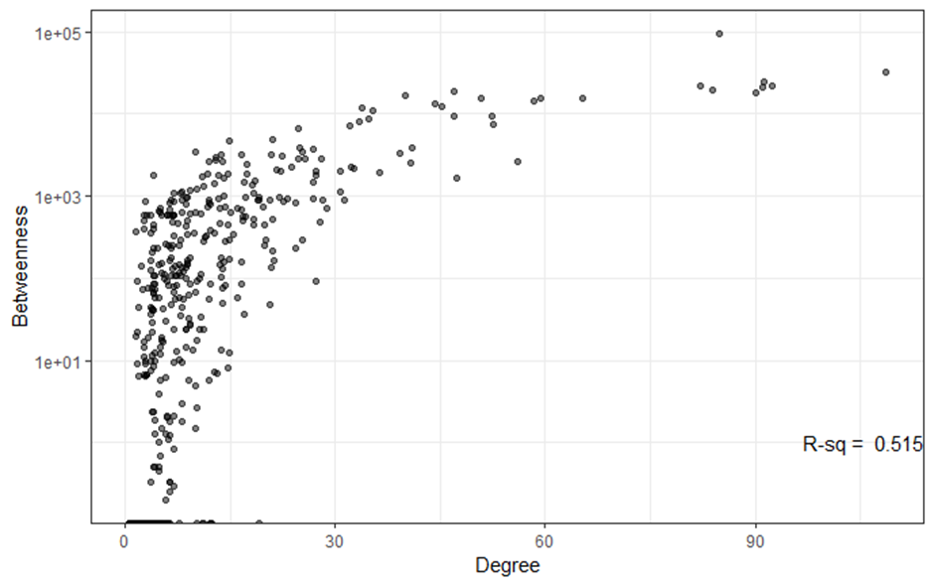

Slide 9
Correlation plots
28. Eigenvector Centrality
EigenCentrality measures a node’s influence based on the number of links it has to other nodes within the network.
EigenCentrality then goes a step further by also taking into account how well connected a node is, and how many links their connections have, and so on through the network.
29. PageRank
PageRank is a variant of Eigen Centrality, also assigning nodes a score based on their connections, and their connections’ connections. The difference is that PageRank also takes link direction and weight into account so links can only pass influence in one direction and pass different amounts of influence.
31. Get communities / clusters
32. filtering graph to get important nodes based on degree
33. Fast greedy clustering
34. get total pages in each cluster
get page names in each cluster
get modularity score
Modularity is one measure of the structure of networks or graphs. Networks with high modularity have dense connections between the nodes within modules but sparse connections between nodes in different modules.
37. edge betweenness clustering

Slide 10
RESULTS AND DISCUSSION
By reading in the graph and viewing its summary, we see that the graph contains 582 rows (pages) and 6 columns – id, name, category, fans, talking_about, post_activity
By aggregating pages based on their category, we see that athletes account for the highest no. of pages among all of them, being 151 in number, followed second by ‘Sports Team’ having 77 pages, and so on.
When we look at the top pages based on their fan count (likes), we find that Cristiano Ronaldo from the Athlete category has the highest no. of fans (~119 million), followed by FC Barcelona (95.5 million) and Manchester United (72 million) from the Sports Team category.
When we look at the top pages based on people talking about them, we find that Cristiano Ronaldo from the Athlete category is on the top with 3.5 million people talking about him, followed by FC Barcelona (1.63 million) and Manchester United (1.62 million) from the Sports Team category.

Slide 11
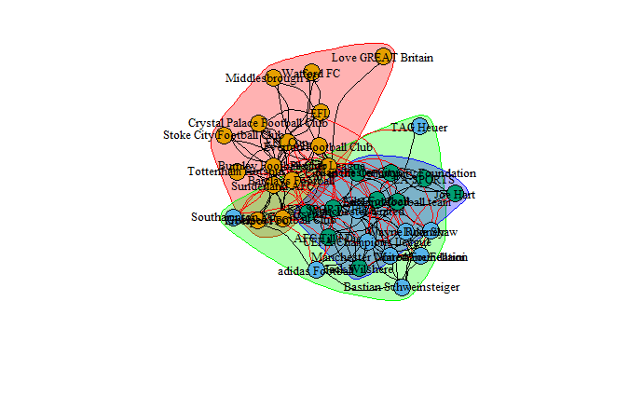
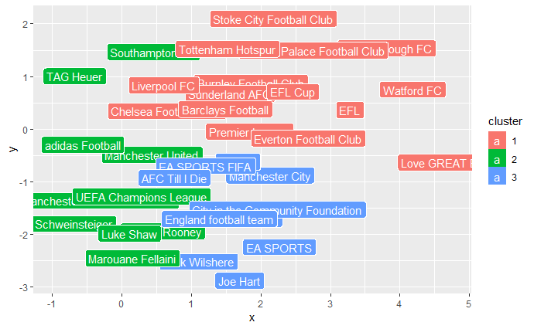
Modularity

Slide 12
5) When we look at the top pages based on page posting activity, we see that SportsPesa Care from the Product / Service category is on the top with 21.74 posting activity, followed by GiveMeSport – Football (10.54) from the News / Media website category and Virgin Media (9.94) from the Telecommunication Company category.
6) The correlation plot b/w talking about and fans shows a positive correlation with the R-squared measure being 0.659 indicating that the 2 features are closely related.
Pages like ‘Premier League’, ‘Burnley Football Club’ and ‘Crystal Palace Football Club’ have 11 as their coreness and thus form the core of the network. Pages like these are important to the network.
Pages like ‘Henrik Lundqvist’, ‘Cara Delevingne’ and ‘Patrick Dempsey’ have the least coreness of 1 and thus form the periphery of the network. Pages like these are not important to the network and they generally exist as a outlier in the network diagram.
Manchester City has the highest degree centrality of 109, thus it has the most no. of connections in the network (it’s connected to max. no. of other pages).
Premier League has the highest closeness centrality of 0.534, thus it tends to have the least average distance from all other nodes.
Premier League also has the highest betweenness centrality of 96082, thus it has the highest tendency to come in the path connecting most other nodes.

Slide 13
NOVELTY
Through our project, we can analyze various networks by Social Network Analysis (SNA), which allow us to better understand how individuals are connected, and most importantly, how information flows – this is critical for improving communication and mobilizing knowledge.
Pages like ‘Premier League’, ‘Burnley Football Club’ and ‘Crystal Palace Football Club’ have highest coreness and thus form the core of the network. This information can be used by Facebook to run advertisements on these pages and the advertisement company gets new customers.
Manchester City has the highest degree centrality of 109, thus it has the most no. of connections in the network. It can be used to convey social messages during emergencies.
Clusters and individuals were also grouped by distance from the core groups. It analyzed the network of friends based on your friends' relationships to their other friends.
The edge betweenness clustering process yielded 12 communities. These communities can be analyzed further by companies to understand people behavior and help to encourage football and other sport accessories among them.
We can also measure, map, and visualize relationships and information flows between individuals or in a group.

Slide 14
Thankyou

